Slide 1
Gamified Interaction Session #05
Course : GAME6012/ User Experiences
Effective Period : September 2017

Slide 2
Learning Objectives

Slide 3
Gamify interaction?
Naturally, games are a good place to start, given the ongoing devotion games inspire. Consider the social game FarmVille, which peaked at 80 million active users—all acquired in a matter of months. Or the check-in service Foursquare, which has warmed up people to the idea of sharing their location in return for points and badges. In the tech community Stack Overflow, members earn points and privileges through defined activities. These kinds of services hint at the addictive power of games, but there’s much more to a good game than meets the eye.

Slide 5
Do you want to continue?

Slide 6
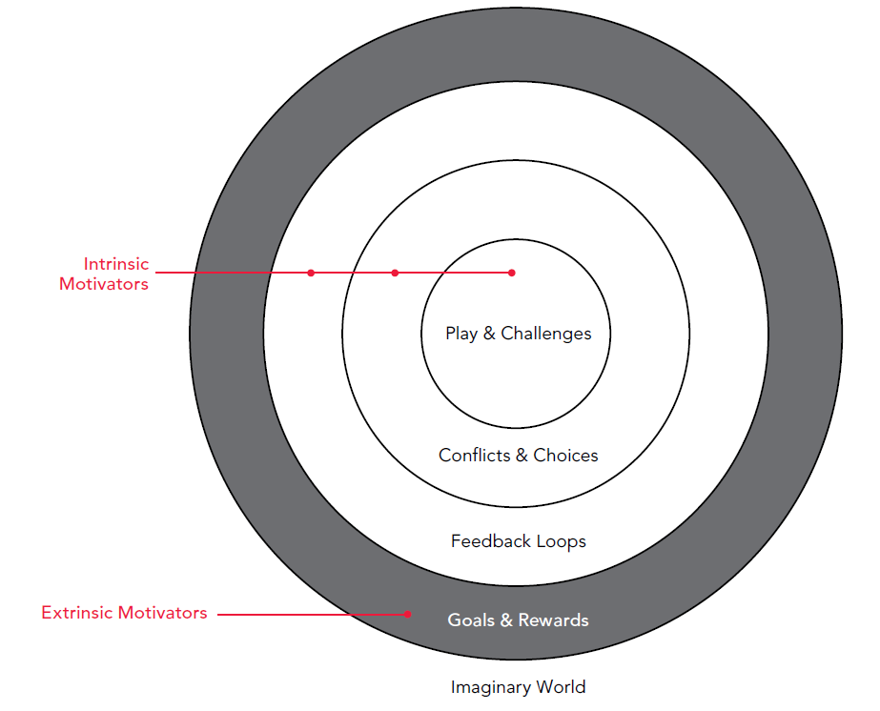

Slide 7
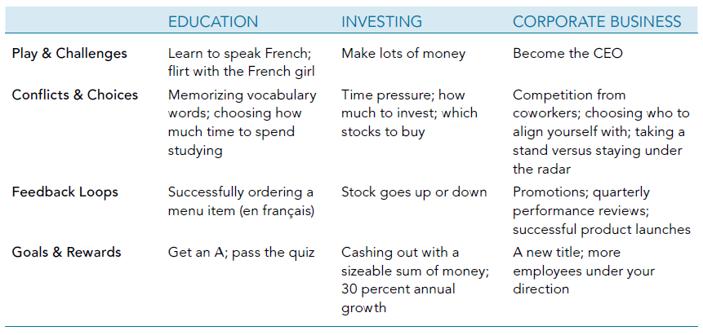
Life is a game

Slide 8

Why gamify?

Slide 9

Why gamify?
6 million gamers in indonesia

Slide 10


Slide 11
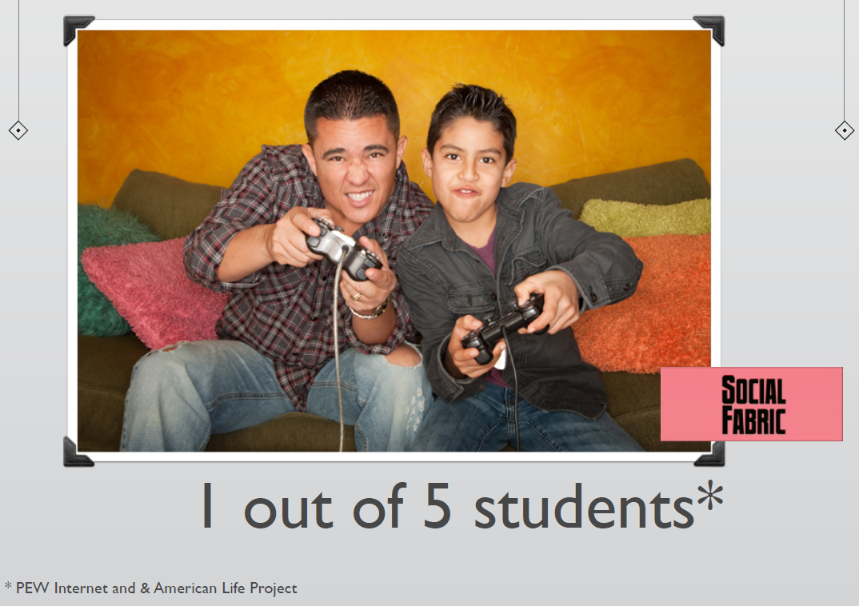

Slide 12
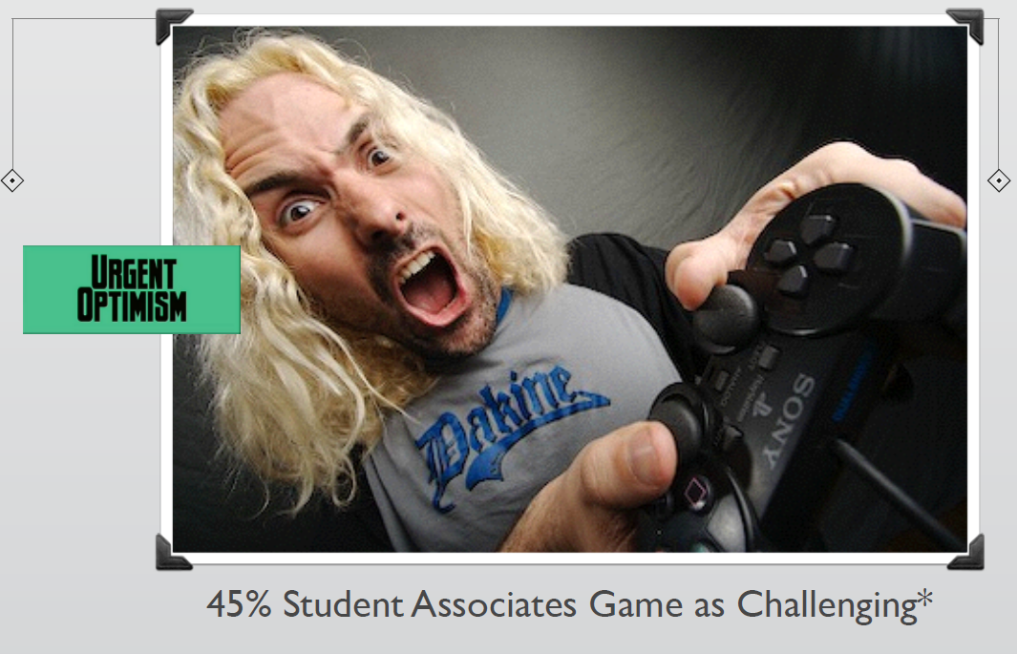

Slide 13
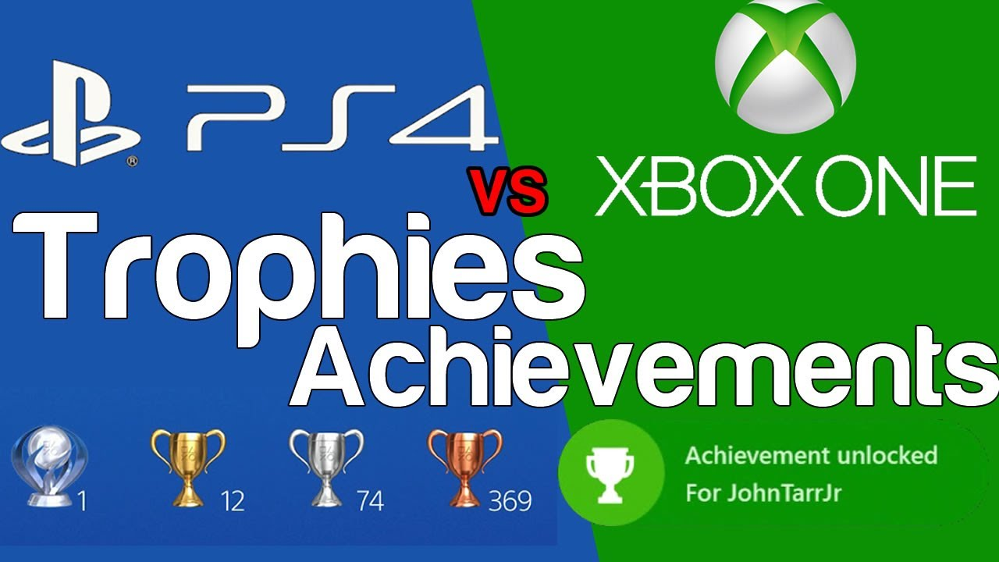
Case study
Gamify a game?

Slide 14
Assignment
Pick one of your favorite retro game
Add gamification to the game to improve the experience

Slide 15
References
Buxton, William. 2007. Sketching user experience. Elsevier
Anderson, Stephen. 2011. Seductive Interaction Design. New Riders.
Faranello, Scott. 2016. Practical UX Design. Packt Publishing

